Slide 1
Introduction to Epidemiology and Biostatistics
Class 2: April 28, 2022
Sampling and Inference

Slide 2
Class Information
Dates: Every week on Thursdays, 6 occurrence(s)
Apr 21, 28
May 5, 12, 19, 26
Time: 5:00 – 6:00 pm
Course Website:
https://tilda.tcd.ie/epidemiology-biostatistics-course/
Zoom Link: https://zoom.us/j/96995332761
Questions: Please use CHAT on your zoom page

Slide 3
Class 2 Lecture Outline
Developing a Research Question
Hypothesis Testing
III. Sampling
IV. Statistical Inference
Significance and p-values
VII. Ethics

Slide 5
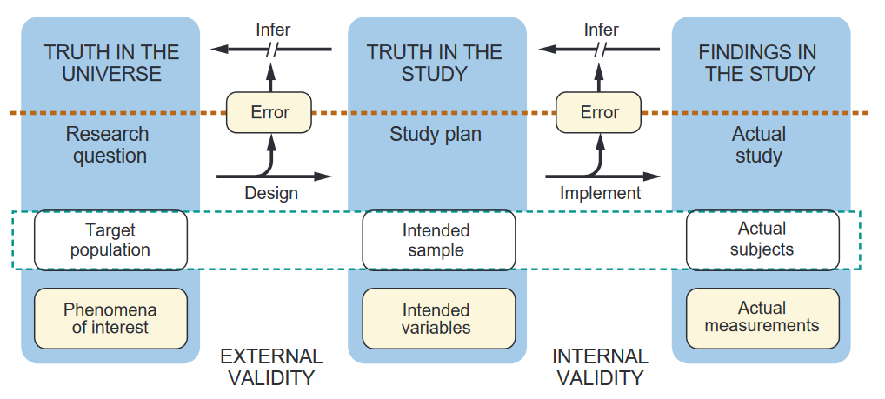
Process for Drawing Conclusions from Research
* Hully, Cummings, et al. 4th ed.

Slide 6
Developing your Research Question
Master the literature
Be alert to new ideas and techniques
Use your imagination!!!
Find a mentor to help with your choices
    Experience
    Time (!!!)

Slide 7
A Good Research Question: FINER
Feasible
      Adequate sample
      Adequate technical expertise
      Affordable
      Scope is manageable
  Interesting
      Intrigues you and your friends!
  Novel
      Extends or refutes previous studies
  Ethical
      DO NO HARM – IRB approved
  Relevant
      To scientific knowledge
      To clinical and health policy
      To future research

Slide 8
Last sentence of INTRODUCTION:
Since previous studies on the mortality risk associated with loneliness and/or social isolation have not explicitly captured combinations of the two constructs, our aim was to examine whether the concordance and discordance between the two was associated with increased mortality risk.

Slide 9
Research Hypothesis
Restatement of the study question
Summarizes the main elements of the study
      Sample
      Predictor
      Outcome
Examines if an association is present
  - Descriptive studies do not need a hypothesis (in general)
Establishes basis for statistical testing
Should be declared prior to the study being done

Slide 10
Terminology
Y = Dependent Variable =
Outcome: disease or condition of interest
X = Independent Variable =
Risk Factor: that which may affect the outcome
Predictor: predicts an outcome
Exposure: that factor or characteristic which may affect or increase risk of a specific disease or other outcome
Intervention: something done to modify the outcome

Slide 11
Hypothesis Testing
Null Hypothesis: proposes that predictor and outcome variable are not associated.
Alternative Hypothesis: proposes that they are associated.
H0 : There is no difference between groups.
HA : There is a difference between groups.
The alternative hypothesis is either:
      One sided = we state direction of the association (+ or -)
      Two-sided = both directions will be tested (we are unsure which way)

Slide 12
ABSTRACT: The cerebrovascular effects of supine hypertension (SH) are still poorly understood. With aging and atherosclerosis of the vascular system, it is not uncommon for SH and non-neurogenic orthostatic hypotension to co-occur. Given evidence for end organ damage and more extreme cerebral dysfunction in those with SH-orthostatic hypotension, we hypothesized that SH would be associated with impaired cerebral autoregulation. The aim of this study was to characterize the cerebrovascular response to orthostasis. Near-infrared spectroscopy was used to quantify the cerebrovascular response. We analyzed data from Wave 3 of TILDA (The Irish Longitudinal Study on Ageing; n=2750). ETC. NOTE: 2-sided test

Slide 13
ABSTRACT
OBJECTIVE: To examine associations of plasma folate concentrations and risk of global
and domain-specific cognitive decline in older people.
END OF INTRODUCTION: Using TILDA data, we investigated the longitudinal associations of folate concentrations with changes in cognitive performance incommunity-dwelling people, including sequential assessments of cognitive function at 2, 4, 6- and 8 years follow-up. We hypothesized that low folate was associated with accelerated cognitive decline in older people living in Ireland.
NOTE: one-sided test

Slide 14
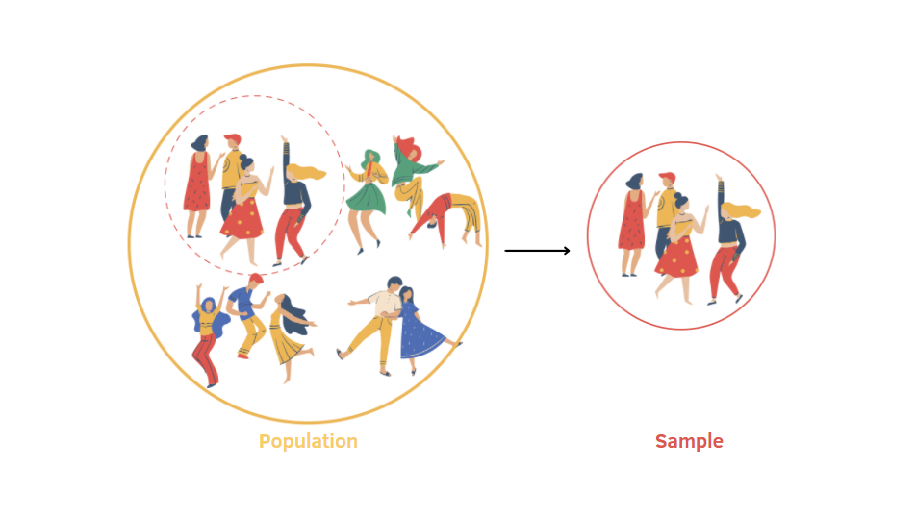
Sampling
Based on probability theory
A sample is pulled to represent the population
Statistics done to provide confidence levels that what we see in the sample is what is occurring in the population

Slide 15

Population
Entire set of people or entities that we want to describe
Must be clearly defined
Represents group to which we want results of our research to be generalized
We will pull our sample from the population

Slide 16

Census
Census includes all population members
Advantages:
      Gives accurate overview of population
      Vital for policy making
Disadvantages:
      Expensive and laborious

Slide 17
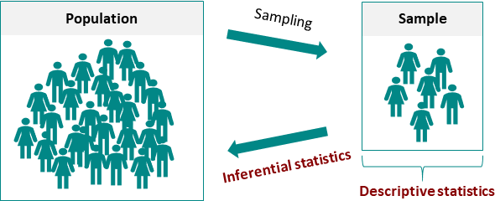
What is a Sample?
Sub-set of the population
Requires a sampling frame
Representative samples allow us to infer to the population (i.e. generalize)
Why? Cheaper, faster, more info can be collected

Slide 18
Types of Sampling
Probability Sampling
Every person has same chance of inclusion
      (Simple) Random = ideal
      Systematic
      Stratified
      Cluster
Non-Probability Sampling
Chance of inclusion are not known beforehand
Does not allow us to generalize about population
      Convenience
      Voluntary Response
      Snowball

Slide 19
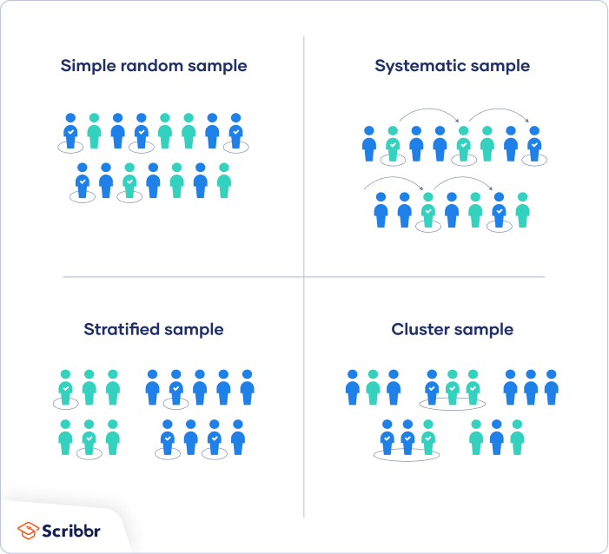
Random Sampling
Every member of the population
has an equal chance of being
selected.
Your sampling frame should include the whole population.
Use tools like random number generators or other techniques that are based entirely on chance.
https://www.scribbr.com/methodology/sampling-methods/

Slide 20
Systematic Sampling
Similar but it is easier to conduct than simple random sampling.
Every member of the population is listed with a number, but instead of randomly generating numbers, individuals are chosen at regular intervals
First number generated randomly before moving to intervals

Slide 21
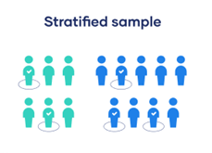
Stratified Sample
Divide the population into subpopulations (strata) that may differ in important ways
Ensure that every subgroup is properly represented in the sample
Based on the overall proportions of the population, calculate # people from each subgroup
Use random or systematic sampling to select a sample from each subgroup

Slide 22
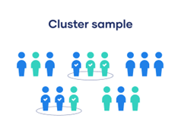
Cluster Sample
Divide the population into subgroups
Each subgroup should have similar characteristics to the whole sample
Randomly select entire subgroups
. Good for dealing with large and dispersed populations
May more risk of error in the sample if there are substantial differences between clusters.

Slide 23
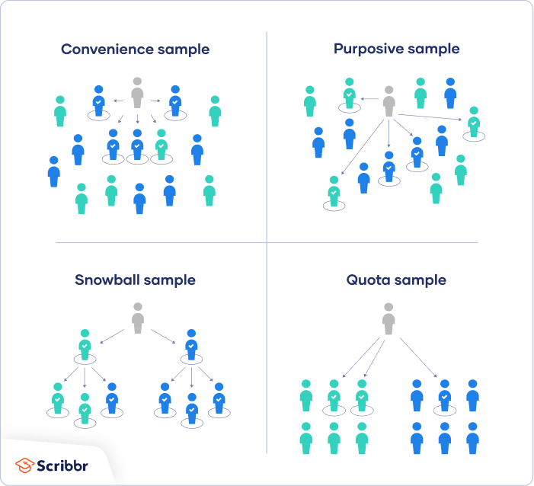
Non-Probability Samples
Convenience Sample: individuals who happen to be most accessible to the researcher
Voluntary Response Sampling: People volunteer themselves (e.g. by responding to a public online survey)
Snowball Sampling: Recruit participants via other participants. The number of people you have access to “snowballs” as you get in contact with more people
Purposive Sampling (Judgement Sampling): using yourr expertise to select a sample that is most useful to the purposes of the research
      often used in qualitative research
NO WAY to tell if the sample is representative of the population so it can’t produce generalizable results.

Slide 24
Key Points to Remember
Good quality samples are key to survey research!
Probability samples allow generalizations back to the population we sampled from
You cannot generalize from a sample if non-probability methods were used!
Allows you to use inference

Slide 25
SAMPLE
DESIGN
Target Population
“The target population for the TILDA survey is the population of persons aged 50 or over living in residential addresses in the Republic of Ireland, and their spouses or partners of any age. A probability sample of this population gives each member of the population a known, non-zero probability of being selected.”
Sampling Frame
“The RANSAM system, based on the Geodirectory, which has been developed by the Economic and Social Research Institute (ESRI) of Ireland (Whelan, 1979).”

Slide 26
Two-Stage Sample Design
Stage 1
“RANSAM groups the residential addresses in the country into 3,155 first stage units or clusters. These clusters are townlands or aggregations of townlands and range in size from 500 to 1180 addresses. It was decided to select 640 of these clusters, with implicit proportionate stratification of clusters by socio-economic group (3 categories) and geography.”
Stage 2
“This stage involved the selection of a probability sample of 50 addresses within each cluster (10 to be held in reserve). The combination of selection probabilities used at the two stages produces an equal probability (“epsem“) sample of addresses. All persons aged 50 or over in the selected households (and their spouses or partners of any age) are asked to participate.”

Slide 27
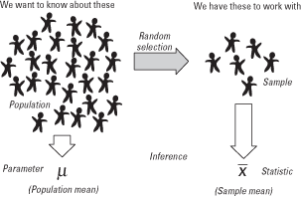
Inference

Slide 28
Inference from Sample to Population
Inferential statistics vs descriptive statistics
Drawing conclusions for population from a sample
Sample parameters (e.g. sample mean) likely to fall near the middle of the normal distribution (i.e. population mean) and less likely to be very far from the middle
Can be quantified via Confidence intervals

Slide 29
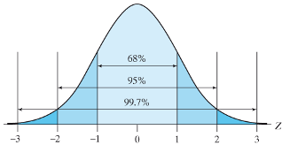
Central Limit Theorem
The sampling distribution of the mean of any independent, random variable will be normal or nearly normal, if the sample size is large enough.

Slide 30
Sampling Error
No random sample, no matter how perfectly selected will exactly represent the population. It is an inevitable part of the sampling process.
Sampling error = error that occurs when a statistic is based on a sample rather than the whole population
Difference between sample estimate and true value of the population parameter
With random sample: it is systematic and highly predictable -> it can be calculated
Affected by size of sample and variability

Slide 31
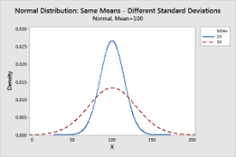
Variability in a Sample

Slide 32
Note: Definitions of each condition were provided POINT or PERIOD PREVALENCE?

Slide 33
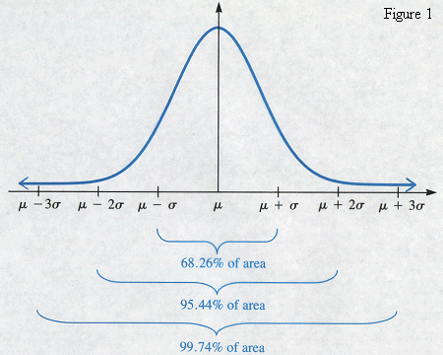
Confidence intervals
95% of the area of a normal curve falls between +/- 1.96 times the standard deviations from the mean
  95% chance that population
  mean is within sample mean
  +/- 1.96 times standard errors
  from the mean
  -> 95 % confidence interval
  90% confidence interval: +/-1.65 x SE
  99% confidence interval: +/- 2.58 x SE

Slide 34
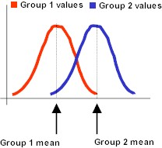
Significance Tests: Comparing Means
When comparing groups, we often want to know if there are differences between them
  We can easily calculate the
  means for two groups
  and their distribution
  (e.g. men and women)

Slide 35
Significance: Comparing Means
How can we be sure that the difference in means is not ‘accidental’ or ‘by chance’, i.e. due to sampling variability?
We need to perform a test of statistical significance (i.e. inferential statistic)
This tests the likelihood of the difference being the outcome of sampling variability, rather than a ‘real’ difference in the population.

Slide 36
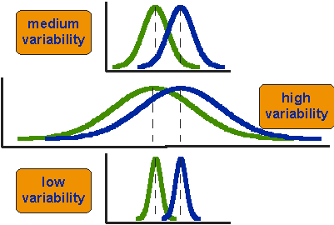
Variability and Difference
The difference between the means in each of these examples is exactly the same, however, we have to judge the difference between their means relative to the spread or variability of their scores
Notes:
Here we can conclude that the difference between the ‘low variability’ groups is the most distinct / important because not much overlap.

Slide 37
What are p-values?
The p-value indicates the likelihood that the result of a particular analysis would be produced as a result of sampling variability rather than actual differences in the population.
p-values will vary between 0 and 1
      High p-values: little confidence in findings
      Low p-values: high confidence in findings
      Typical thresholds (alpha level) reported:
.05 (95% level)
.01 (99% level)
.001 (99.9% level)
Often marked with */**/*** (always check this in tables)
MIGHT THE OBSERVED DIFFERENCE HAVE OCCURRED DUE TO CHANCE

Slide 38
Significance Tests
All significance tests calculate the likelihood that a relationship between variables in a sample is the result of sampling variability rather than the result of a real relationship in the population
i.e. What is the likelihood that an observed pattern would be found in a sample if there is no actual relationship in the population the sample is drawn from?

Slide 39
Association vs Significance
Not the same thing
Association = Relationship = Correlation
Effect Size = Strength of the Association
Strength of association ≠ significance
A weak association may be significant, and a strong association may be insignificant
Depends on effect size and variability of the sample
Interpretation needs to be based on both

Slide 40
Principles of Ethics
RESPECT for persons
      Informed consent
      Protect those with impaired decision-making ability
      Maintain confidentiality
BENEFICENCE
      Scientifically sound research design
      Risks : Benefits are acceptable
JUSTICE
      Benefits and burden distributed fairly
      Protect vulnerable populations
      Equitable access to benefits

Slide 41
IRB Approval
Institutional Review Board
      Guide “research”
      “systematic investigation designed to develop or contribute to generalizable knowledge”
Human Subjects
      Living individuals about whom an investigator obtains data or identifiable private information
TCD IRB
      Trinity Research Ethics Committee
      Policy on Good Research Practice
      Approved as Policy by Board (16th June 2021)
      https://www.tcd.ie/about/policies/Good_Research_Practice_June2021.pdf

Slide 43
Acknowledgements
Siobhan Hedigan, Class Support
Dr. Mark Ward, Content
QUESTIONS?
THANK YOU!

